Slide 2
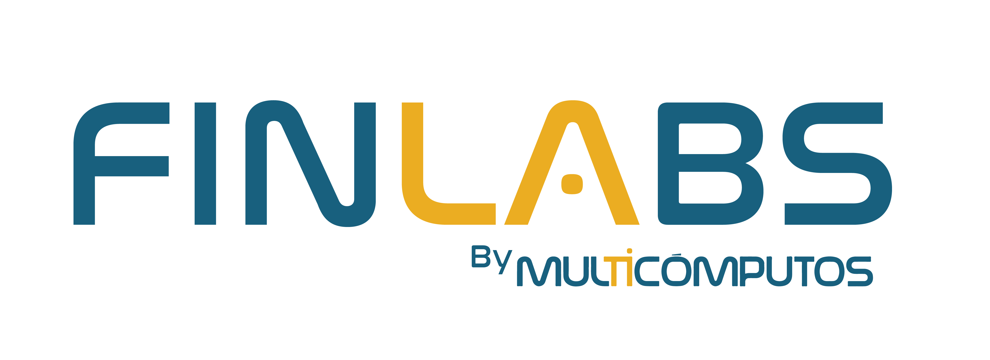
What is Finlabs?
Banking business transformation
Digital Assets custody & tokenization
Cybersecurity: penetration testing & vulnerability assessemnt

Slide 3
Technology Consultants
Global technology partners
35
+100
8
+25
Years in the banking business
Offices in America

Slide 4
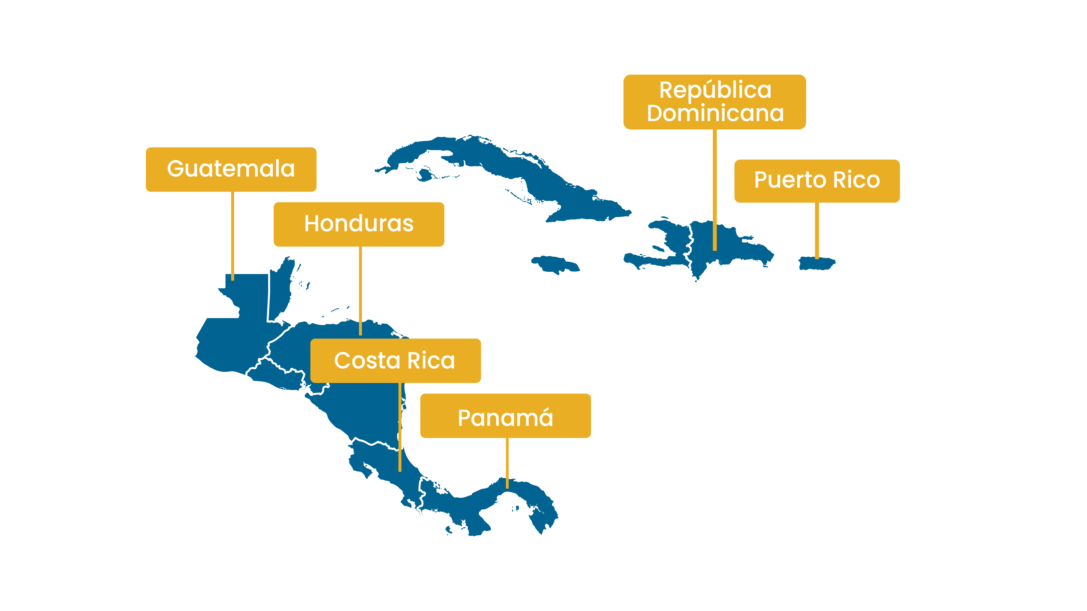

Slide 5
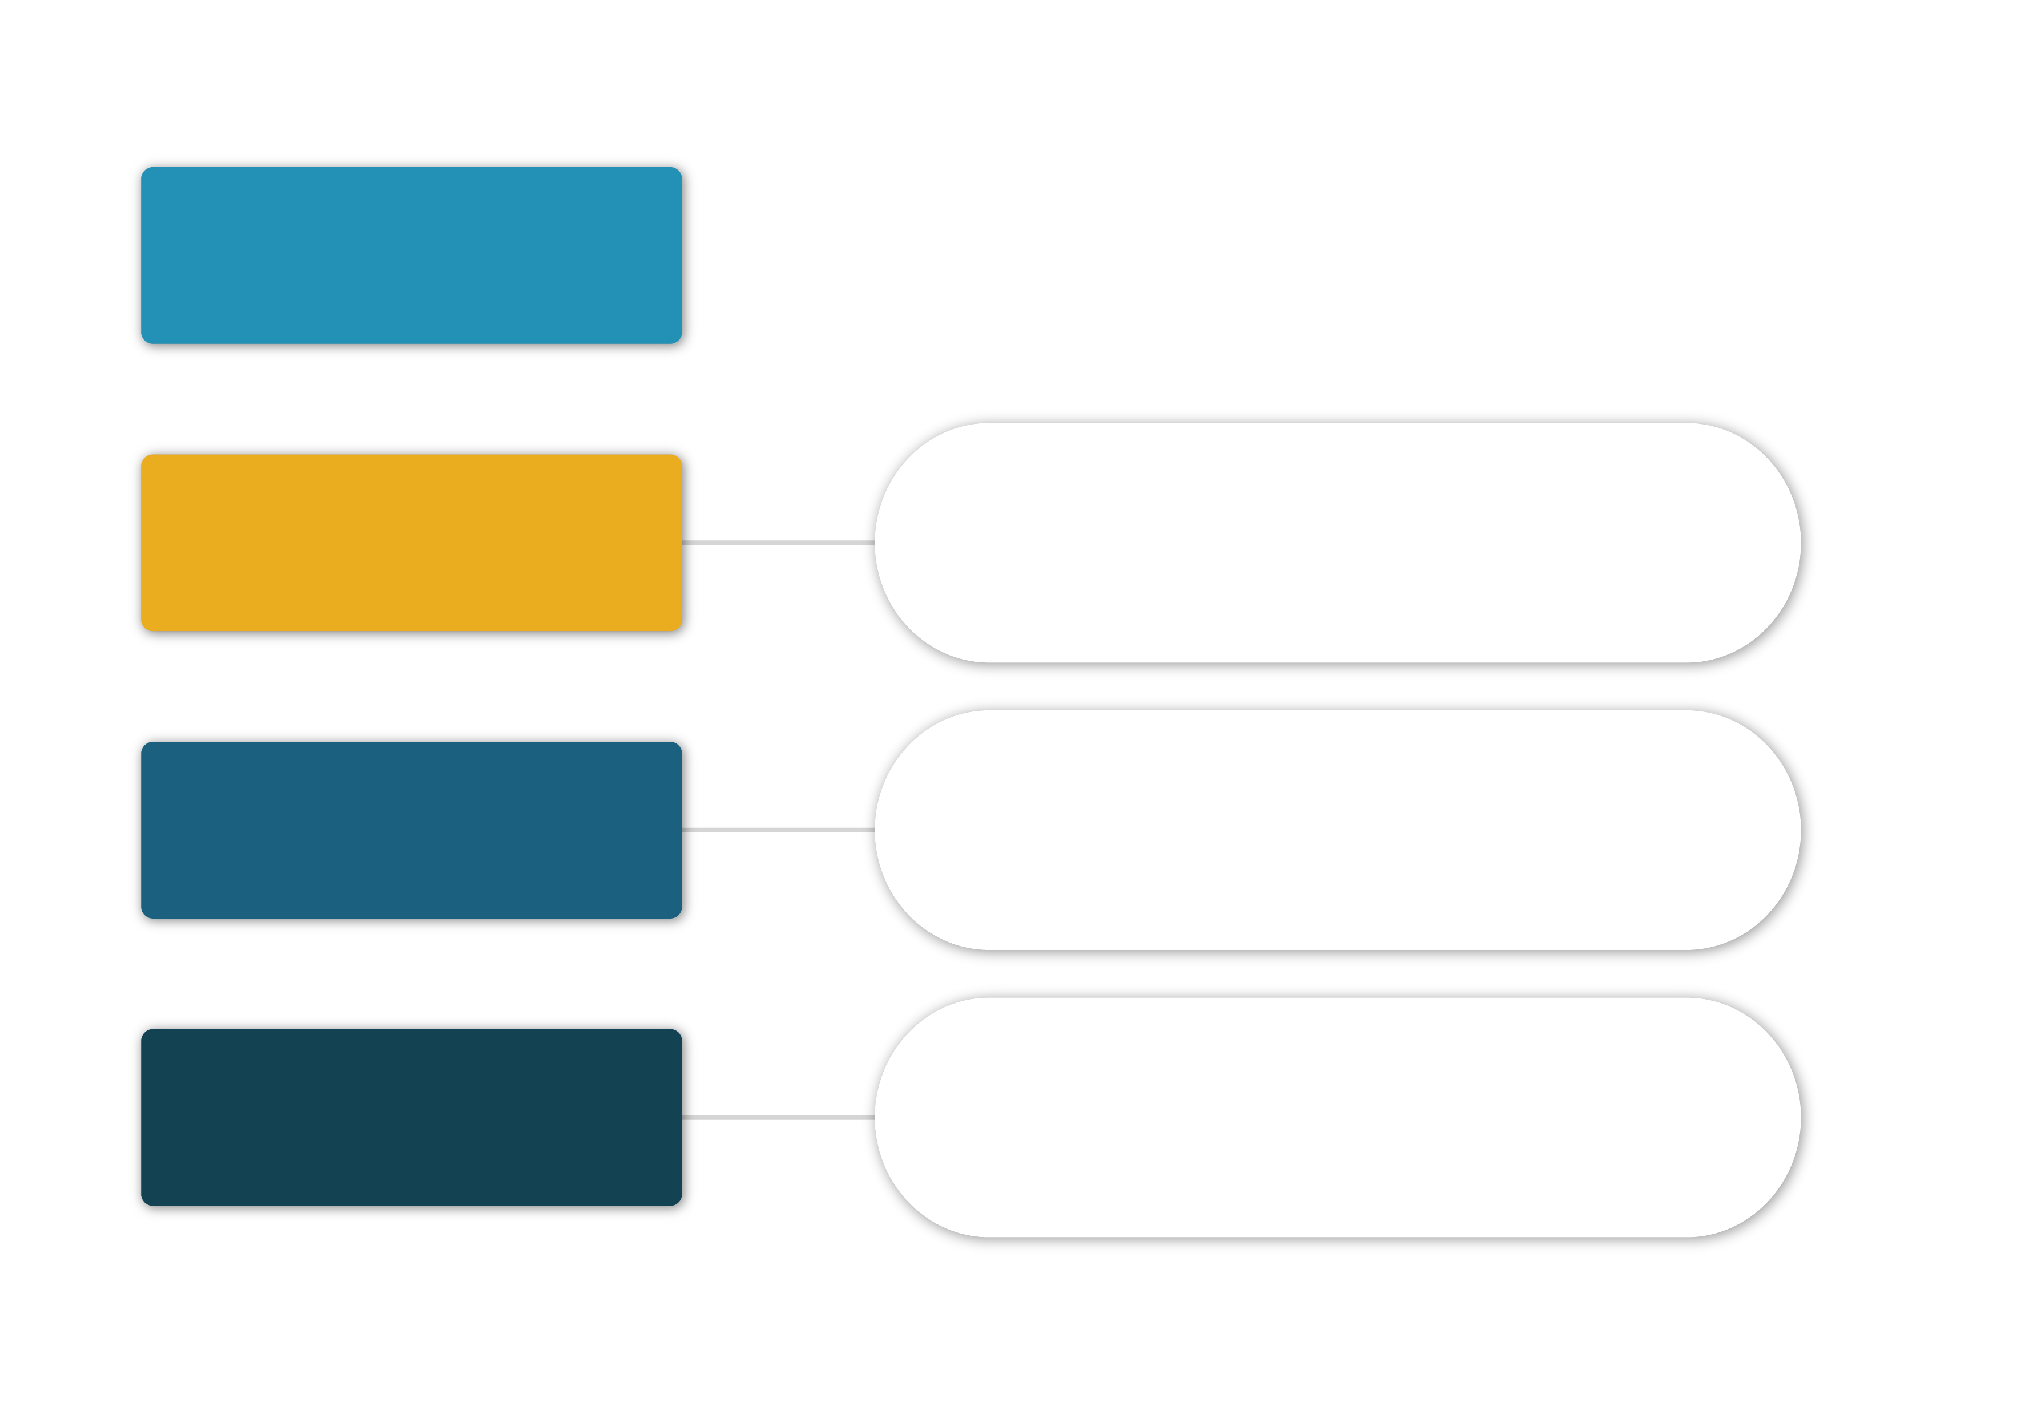
SCOPE
SAAS
Software-as-a-Service
PAAS
Platform-as-a-Service
Applications
IAAS
Infrastructure-as-a-Service
Training
Operating
Systems
Windows​
Solaris
Linux
IA
Infraestructure
Hardware / Software & Virtualization
Servers / Storage​ / HCI
Switches​ / Firewall
Backups Software & Hardware​
EUC
Analytics
Cybersecurity
Datacenter
Infraestructure
A/C - Power​
Building

Slide 6
FINLABS PARTNERS
En proceso

Slide 7
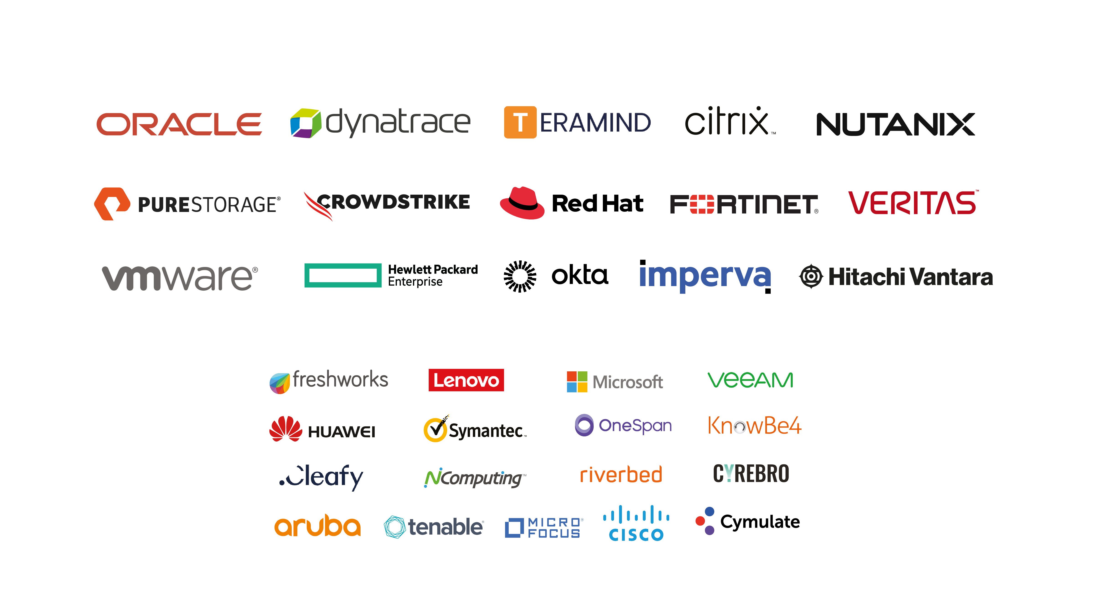
MULTICOMPUTOS PARTNERS

Slide 8
REFERENCES

